Slide 1


Software Group Project IT249 A. Y. 2019-20
Prepared By:
18IT052:Aditya Lalwani
18IT071:Krunal Panchal
Guided By:
Amit Parmar Sir

Slide 2

Medicine Info. through Image
MEDIFO

Slide 3

objective
Mobile application which provide information about the medicine through image provided by user using ML Kit via firebase.
Motivation
As many of us don’t know the exact details of the medicine by its name , its precautions ,side effects and many more . So after dealing and examine such difficulties we decided and it motivated us to build a software which can provide necessary information about the medicine provided by user.

Slide 4
Abstract
Online Android application .
As per prescription user can search medicine and useful information
This application can provide information for all types of medicine
This application provides pre-information of side effects , allergy and much more about medicine.

Slide 5
Tools & Technology
Language : dart language .
Operation System: Windows OS.
Kits: ML kit for text recognization .
IDE : Android Studio (Flutter).
Devices: Android device with minimum API 4 or IOS device with minimum ios version of 9
Libraries: Dart libraries.

Slide 6
DESIGN AND IMPLEMENTATION
The UI of the app is built using Flutter development kit which provide different widgets to built any android Application.
At backend , ML kit has been used to recognize various text present on the medicine
Web scrapping is used for fetching the data from URL .
HTML and json parsing for dynamic content of the medicine .
All these are integrated to build an application called MEDIFO.

Slide 7
Flow chart
START
HOME PAGE
SELECT IMAGE
yes
DETECTING TEXT
no
TEXT RECOGNIZED
no
yes
DISPLAY CONTENT
EXIT

Slide 8
Methodology:-
The project is divided into 4 modules
UI UX
ML vision text kit
Html/json parsing
List view

Slide 9
UI UX
Adobe xd for designing the layout of application
Implementing front end development using FLUTTER material app package using DART language.
Box model is used
A handful of widgets are implemented to achieve desired output.

Slide 10
ML kit – vision text
With ML Kit's text recognition APIs, you can recognize text in English language.
In this project , ML kit has been used for recognizing text from the image of medicine .
In ML kit, we have used custom based models for text recognition.

Slide 11
Html/json parsing
A common use of JSON is to exchange data to/from a web server.
When receiving data from a web server, the data is always in html format and converting it to string.
Parse the data with JSON.parse(), and the data becomes a JavaScript object.
Then data is stored in list<map<string,dynamic>> format.

Slide 12
List viewing
ListView is the most commonly used scrolling widget. It displays its children one after another in the scroll direction. In the cross axis, the children are required to fill the ListView.
We have converted the json format into list of information .
And then displaying the content of medicine .

Slide 13
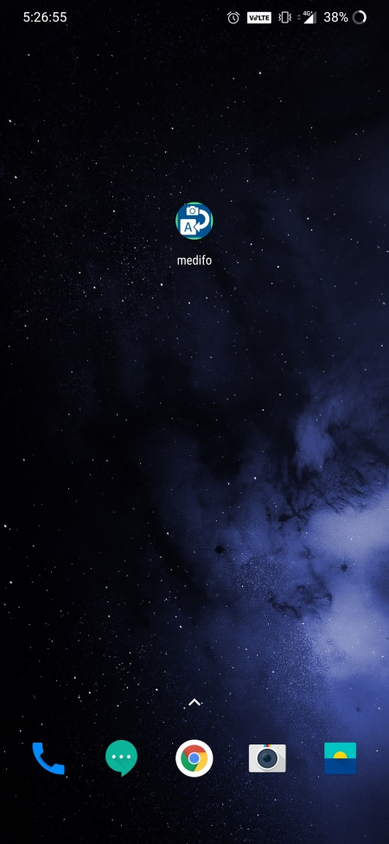
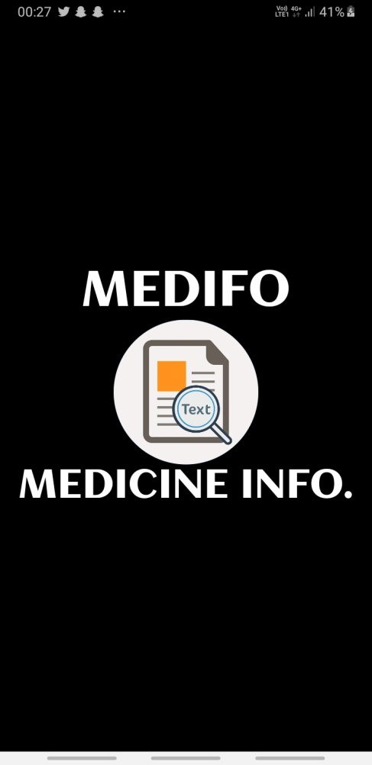
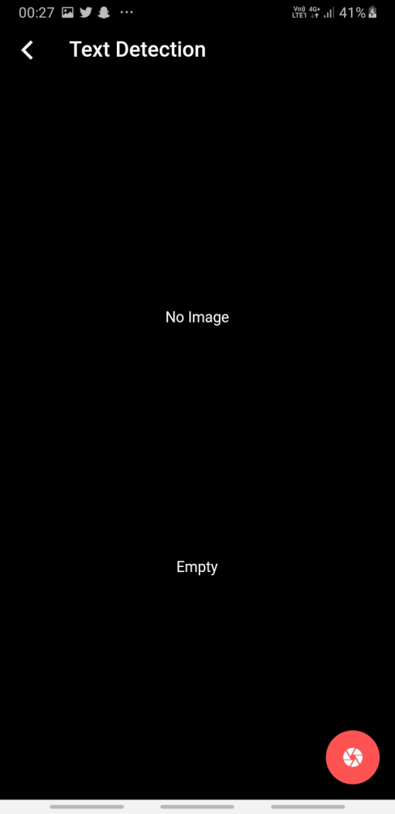
SCREENSHOTS

Slide 14
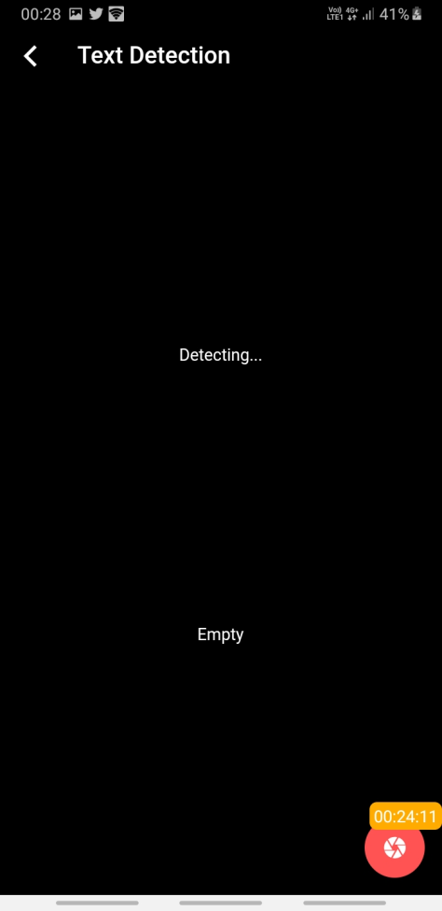
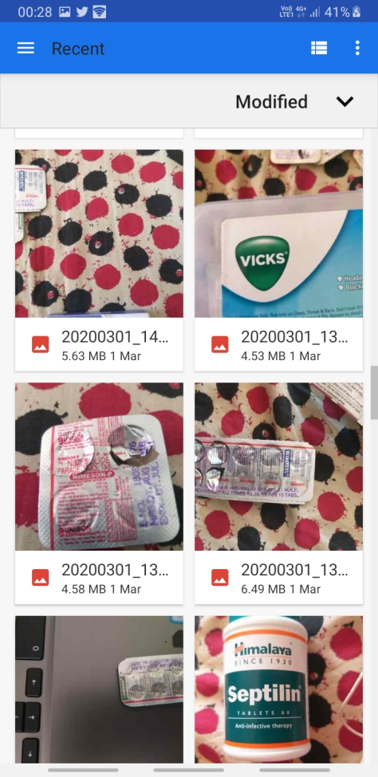
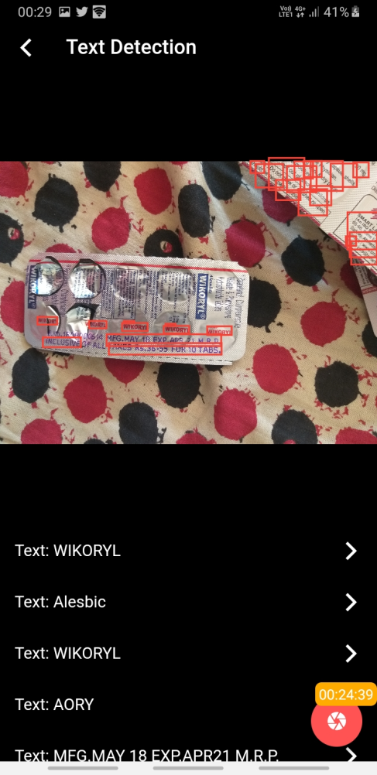

Slide 15
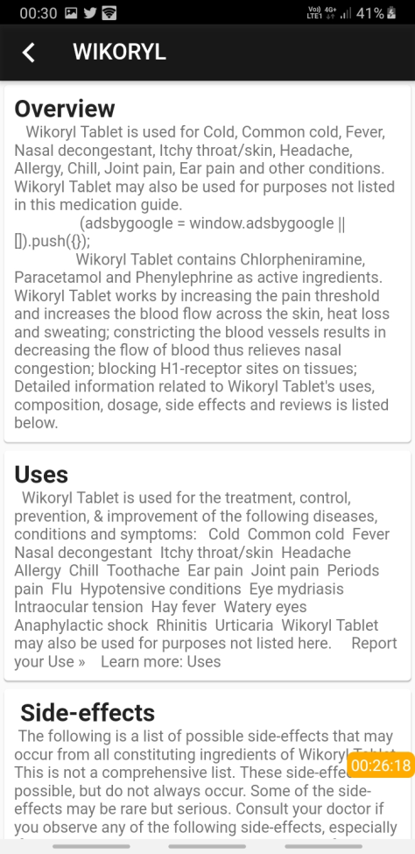
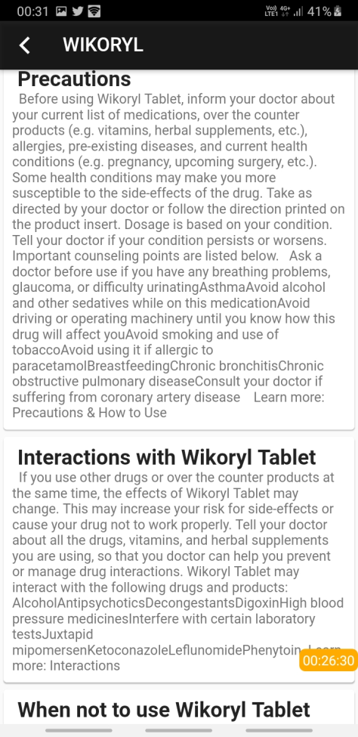

Slide 16
LIMITATIONS AND FUTURE ENHANCEMENT
LIMITATIONS
This app can only process and display data in one language (english) .
Image of medicine is required it cannot be clicked on runtime.
Camera cannot be accessed.
ALL the text are recognised .
FUTURE ENHANCEMENT
Camera will be provided .
User can click the image through app and can get info about it.
Only the name of medicine will be selected via ML .

Slide 17
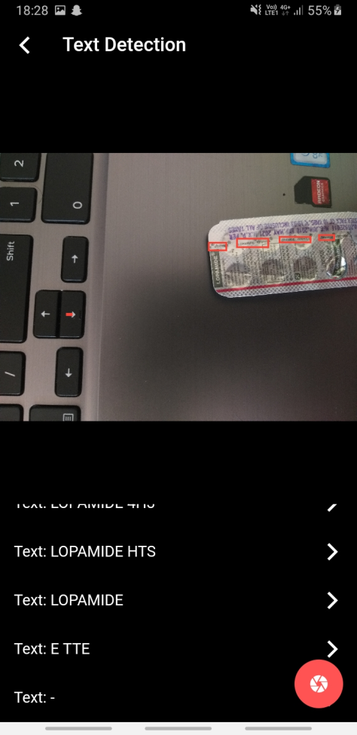
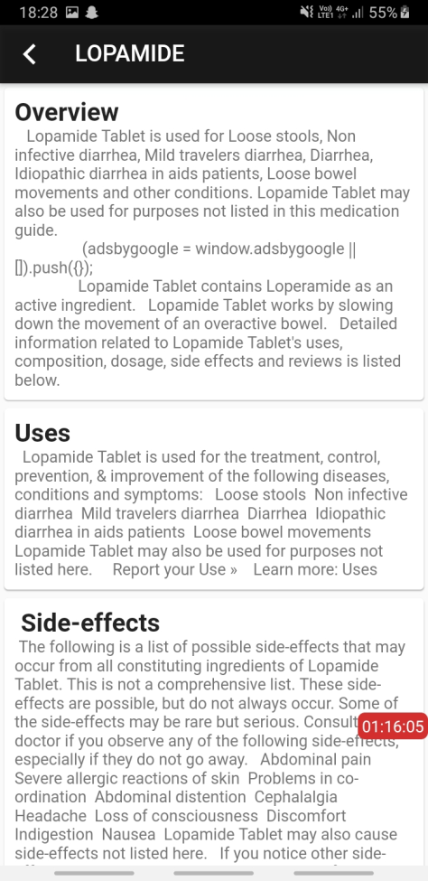
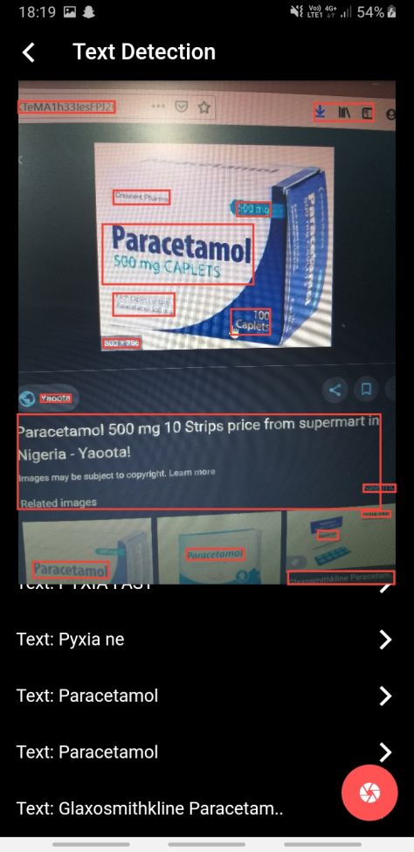
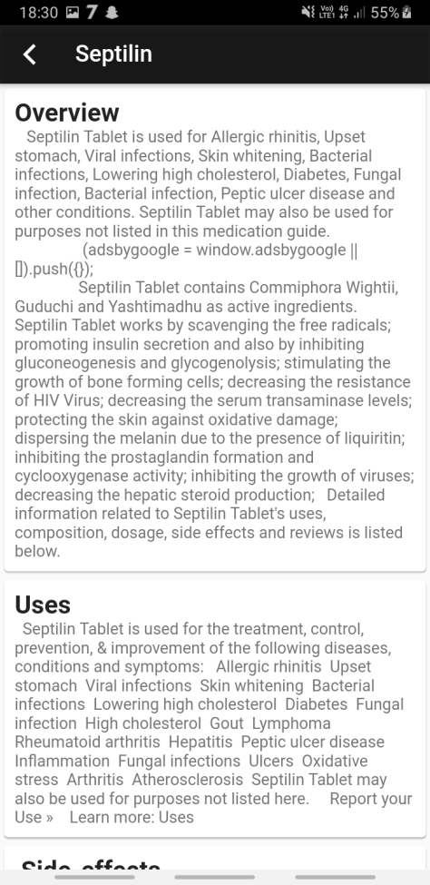
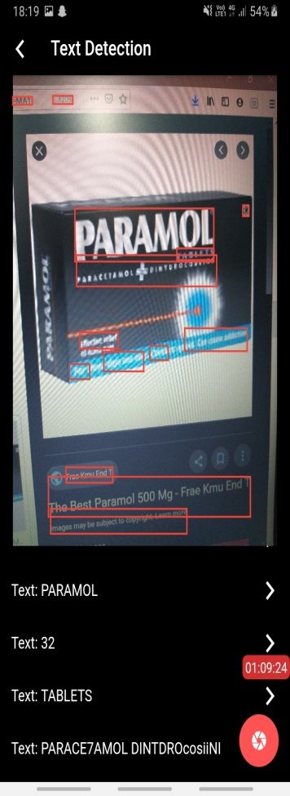
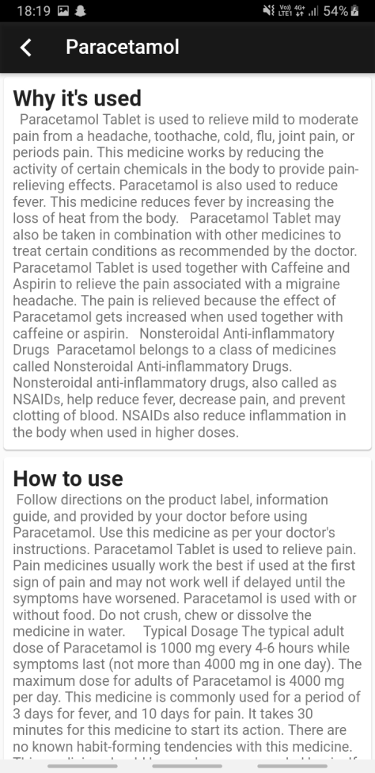

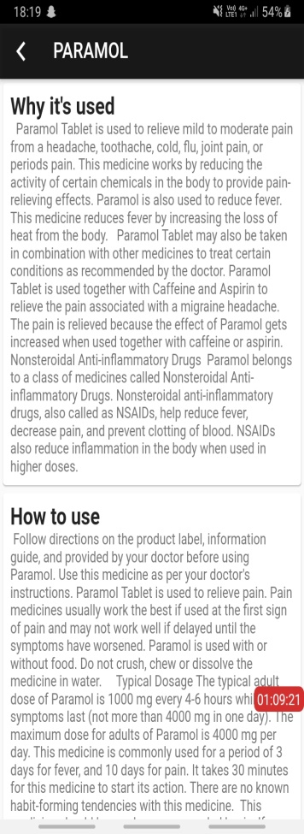
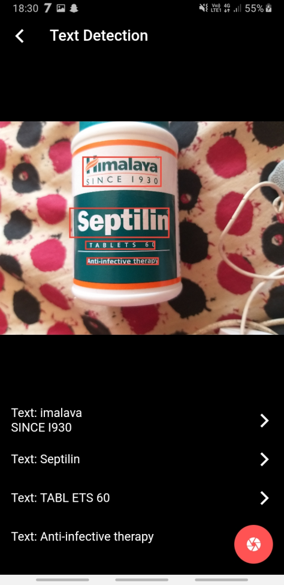
TEST CASES

Slide 18
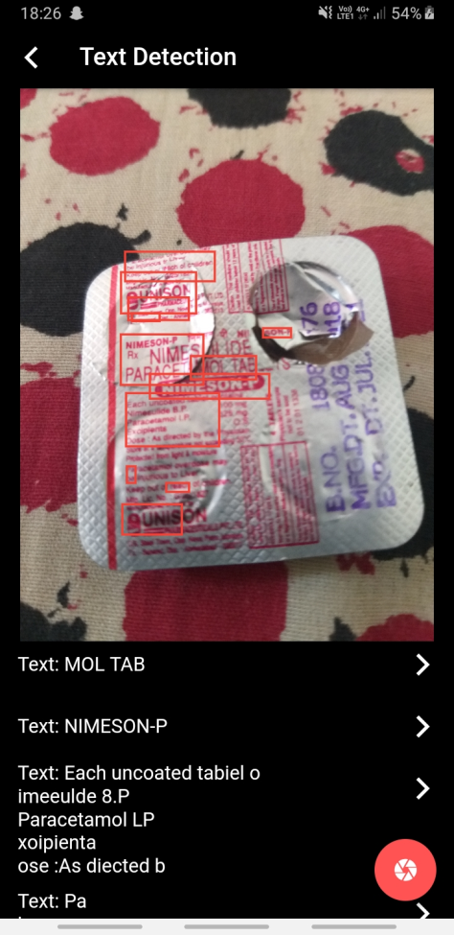
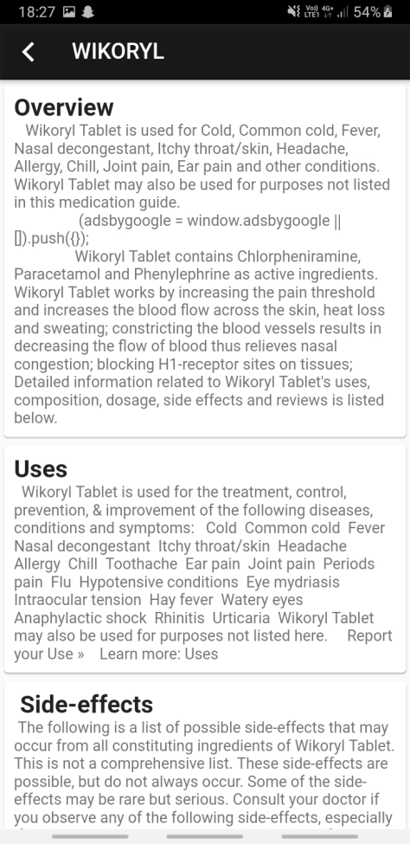
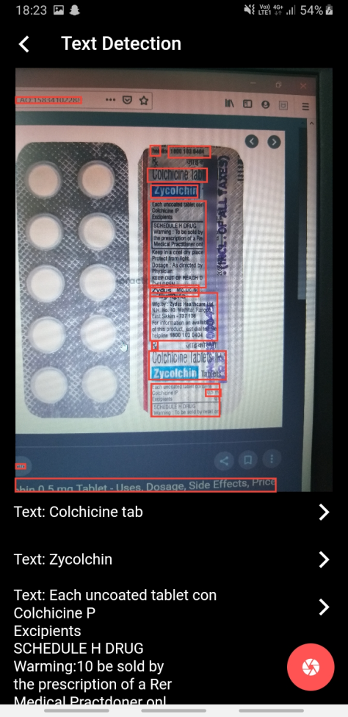
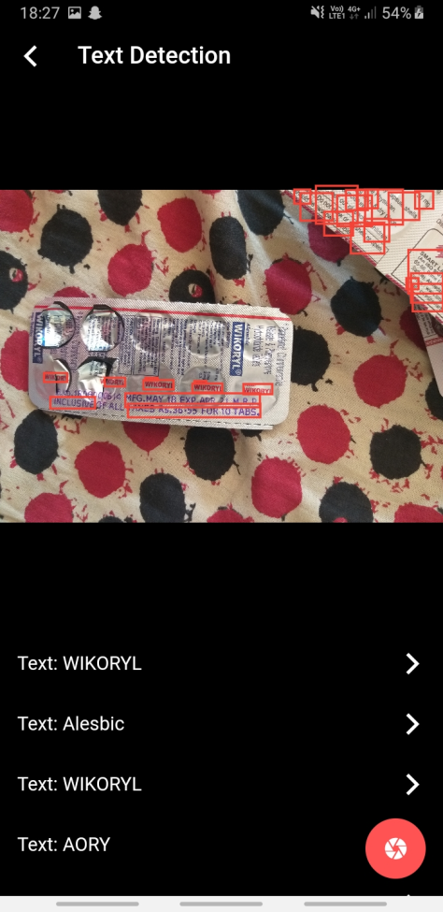
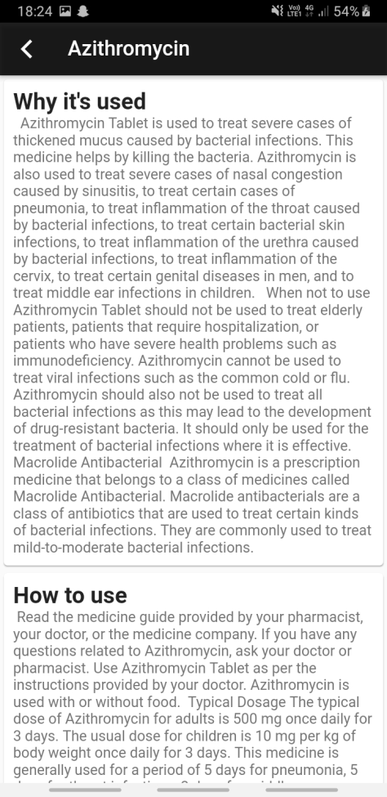
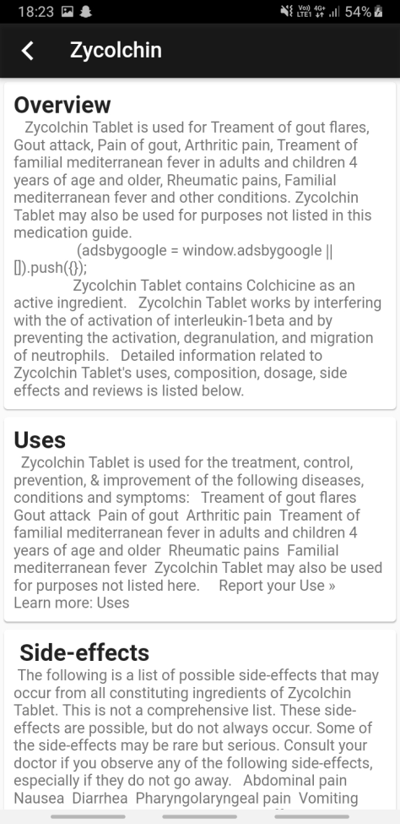
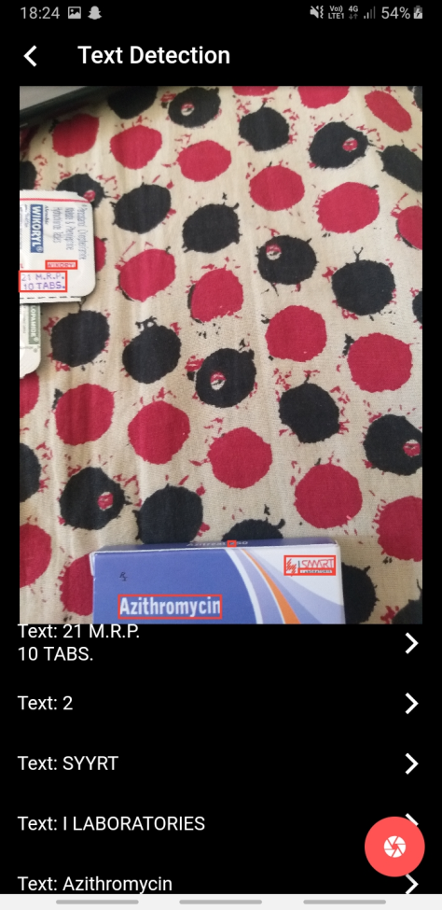
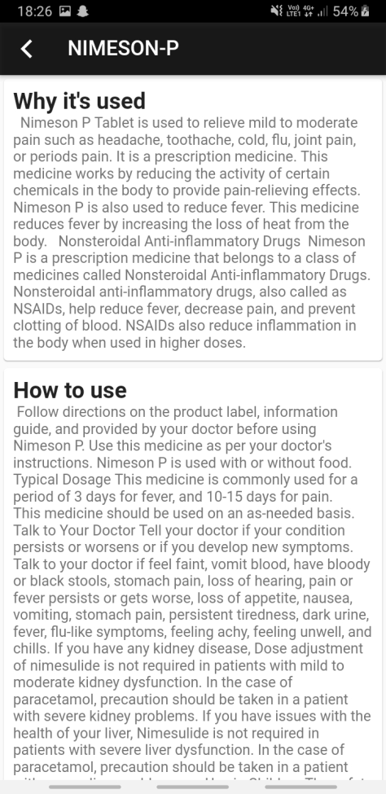
TEST CASES

Slide 19
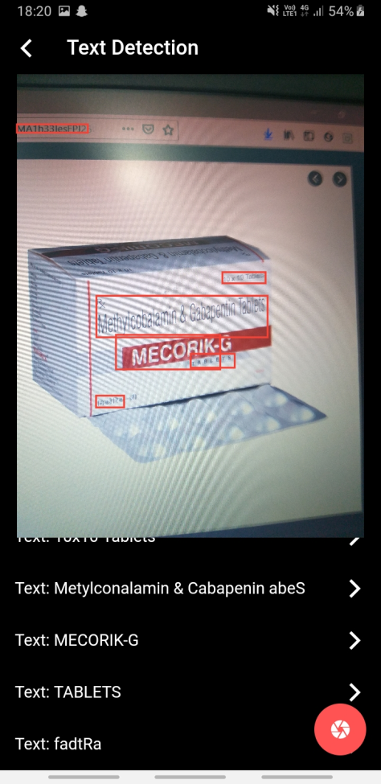
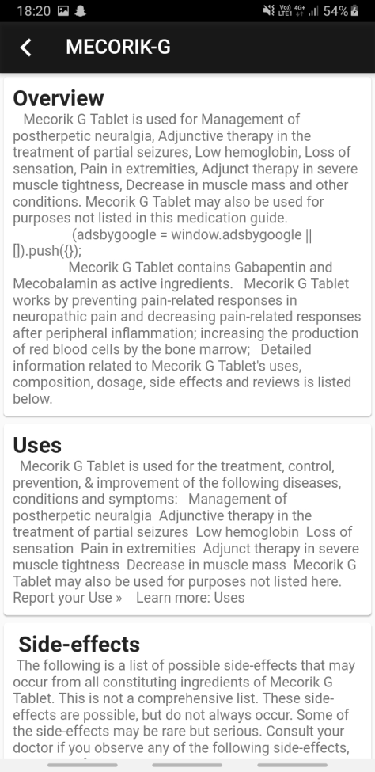
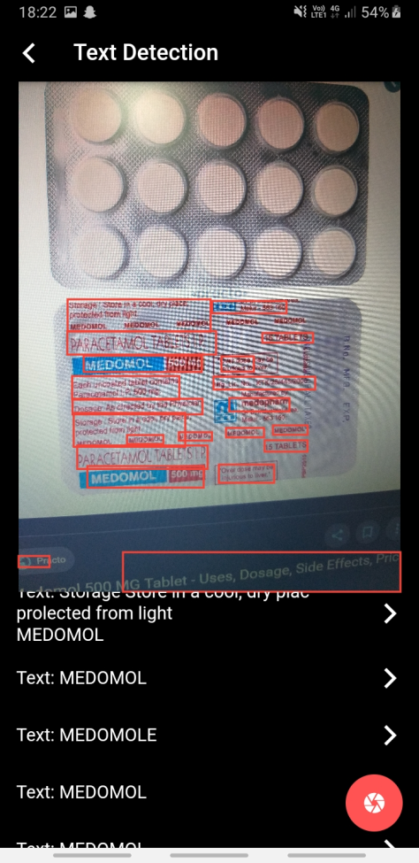
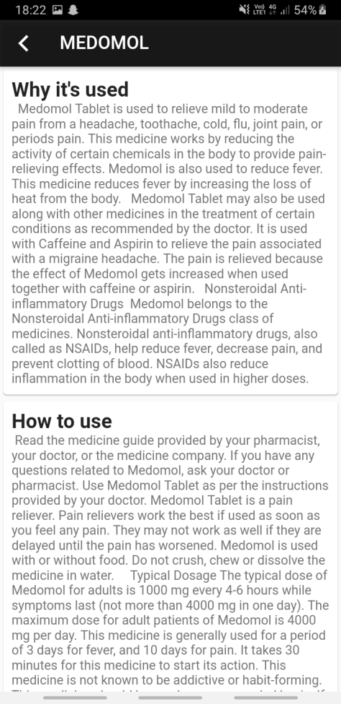
TEST CASES

Slide 20


TEST CASES

Slide 21
TEST CASES

Slide 22
References
References
https://flutter.dev
https://www.udemy.com/course/flutter-bootcamp-with-dart/learn/lecture/14481766#overview
https://www.tabletwise.com/
https://api.flutter.dev/flutter/widgets/ListView-class.html
https://firebase.google.com/docs/ml-kit/recognize-text
https://www.w3schools.com/js/js_json_parse.asp
https://github.com/medicine-details-through-web-scraping

Slide 23




Slide 24
Thank You

